Slide 1

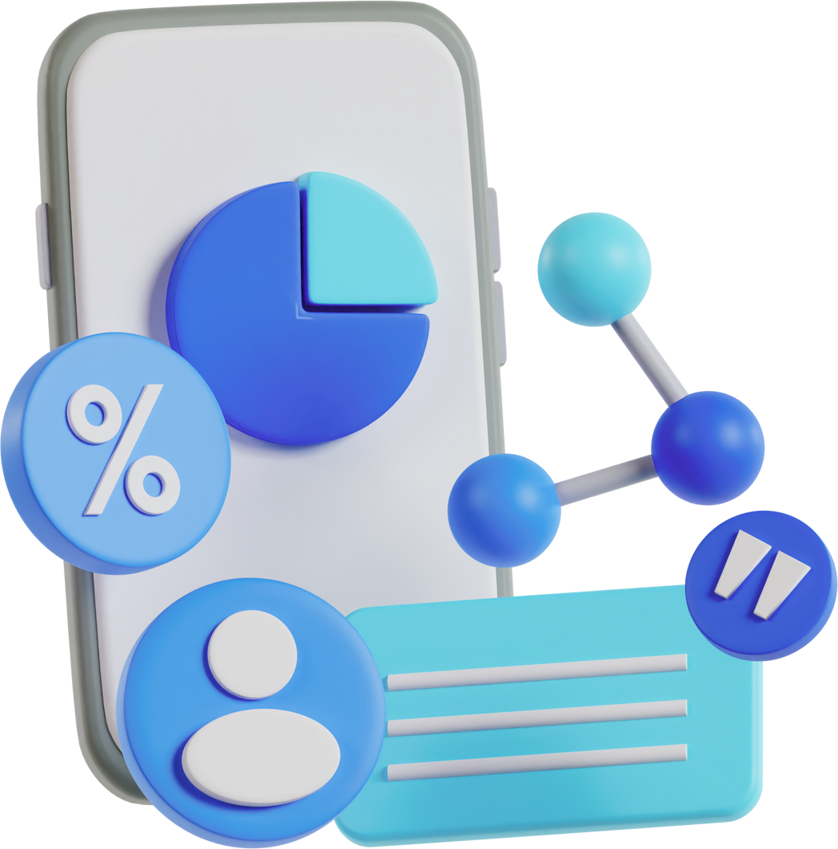
Social Media
Website-facebook-clone
Prepared By: Abhishake Bharti
B.Tech. (CSE - 8 ‘B')
University roll no.: 1919834

Slide 2
Table of Content
1
Introduction
2
Technology used
3
Features and Explanation
4
Project Snapshots
5
Conclusion

Slide 3



Introduction
Social media platforms have become an integral part of our daily lives in today's world.
They have transformed the way we interact, creating virtual communities and opening up new avenues for communication and collaboration.
The website I will be discussing today is a remarkable example of how the MERN stack, consisting of MongoDB, Express.js, React.js, and Node.js, has been utilized to create a dynamic and immersive social media experience.

Slide 4
4
3
2
1
0
2012
2013
2014
2015
2016
2017
2018
2019
2020
2021
2022
Number of Social Media Users (in Billion)
Audience Demographics
The number of social media users has shown consistent growth over the years. Platforms like Facebook, Instagram, Twitter, LinkedIn, and TikTok boast billions of active users collectively.

Slide 5
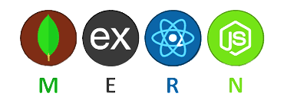
By combining MongoDB for data storage, Express.js for server-side development, React.js for dynamic front-end interfaces, and Node.js for server-side execution, the MERN stack provides a robust and efficient foundation for developing social media websites and other web applications.
Technology Used
Data Storage
Server Side
Develop-ment
MongoDB
Express.js
Other
React.js
Server Side Execution
Node.js
Front End

Slide 6

MongoDB, a popular NoSQL database, is widely used in social media websites for its flexibility, scalability, and ability to handle large volumes of data.
Data Storage
Scalability
Fast and Efficient Queries
Real-time Updates
Flexibile Agile Development
Analytics and Insights

Slide 7
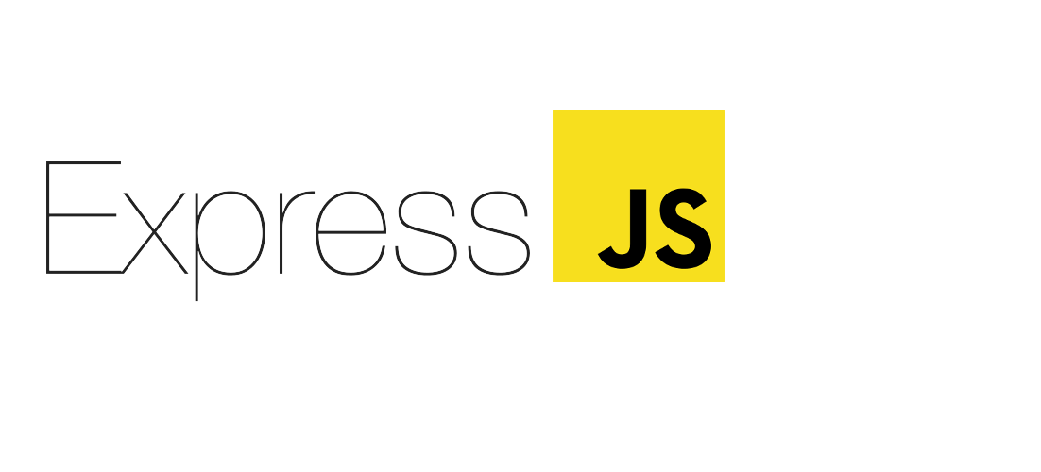
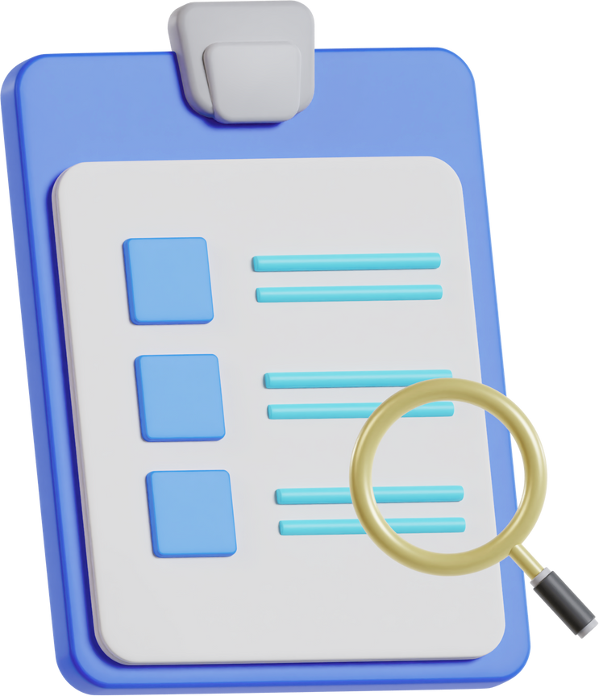
Express.js, a fast and minimalist web application framework for Node.js, plays a crucial role in the development of social media websites.
Routing and Middleware
API Development
Authentication and Authorization
File Uploads and Storage
Real-time Interactions

Slide 8
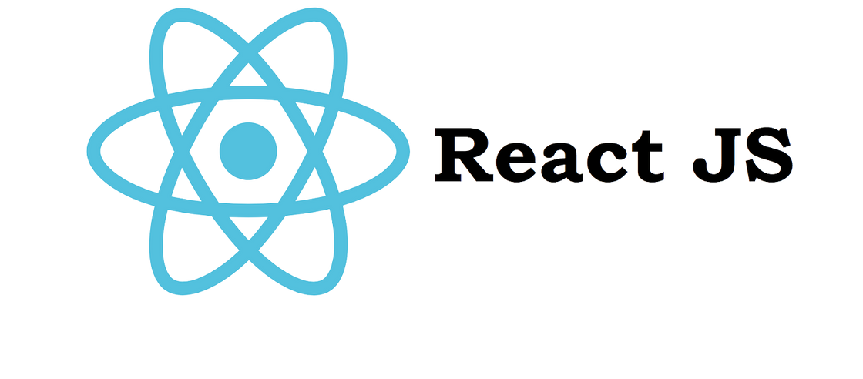
React.js, a powerful JavaScript library for building user interfaces, plays a significant role in the development of social media websites.
Dynamic User Interface
Real-time Updates
Virtual DOM
Component Reusability
State Management

Slide 9
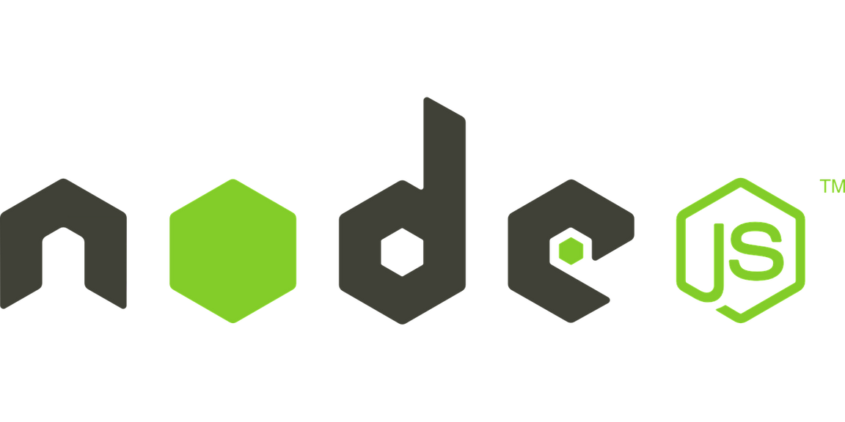
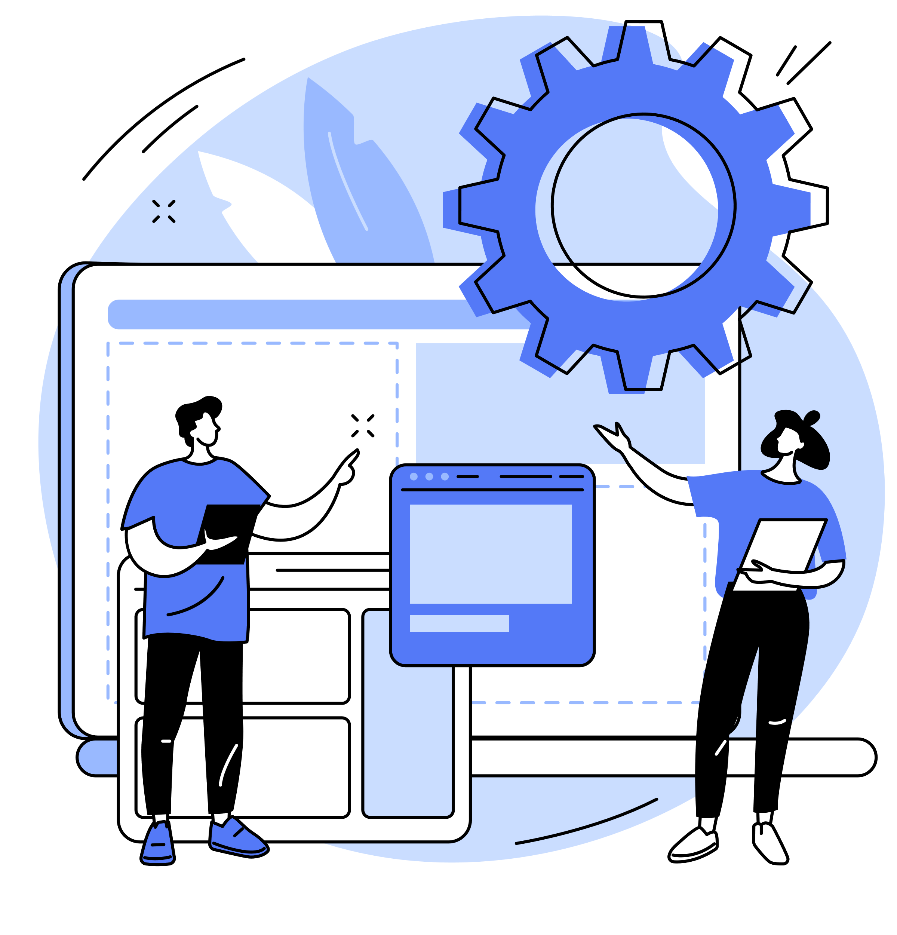
Node.js, a JavaScript runtime environment, is widely used in social media websites for its ability to handle server-side operations and facilitate real-time interactions.
Server-side Development
Scalability and Performance
APIs and Microservices
Integration with Databases
Integration with Frontend Frameworks

Slide 10
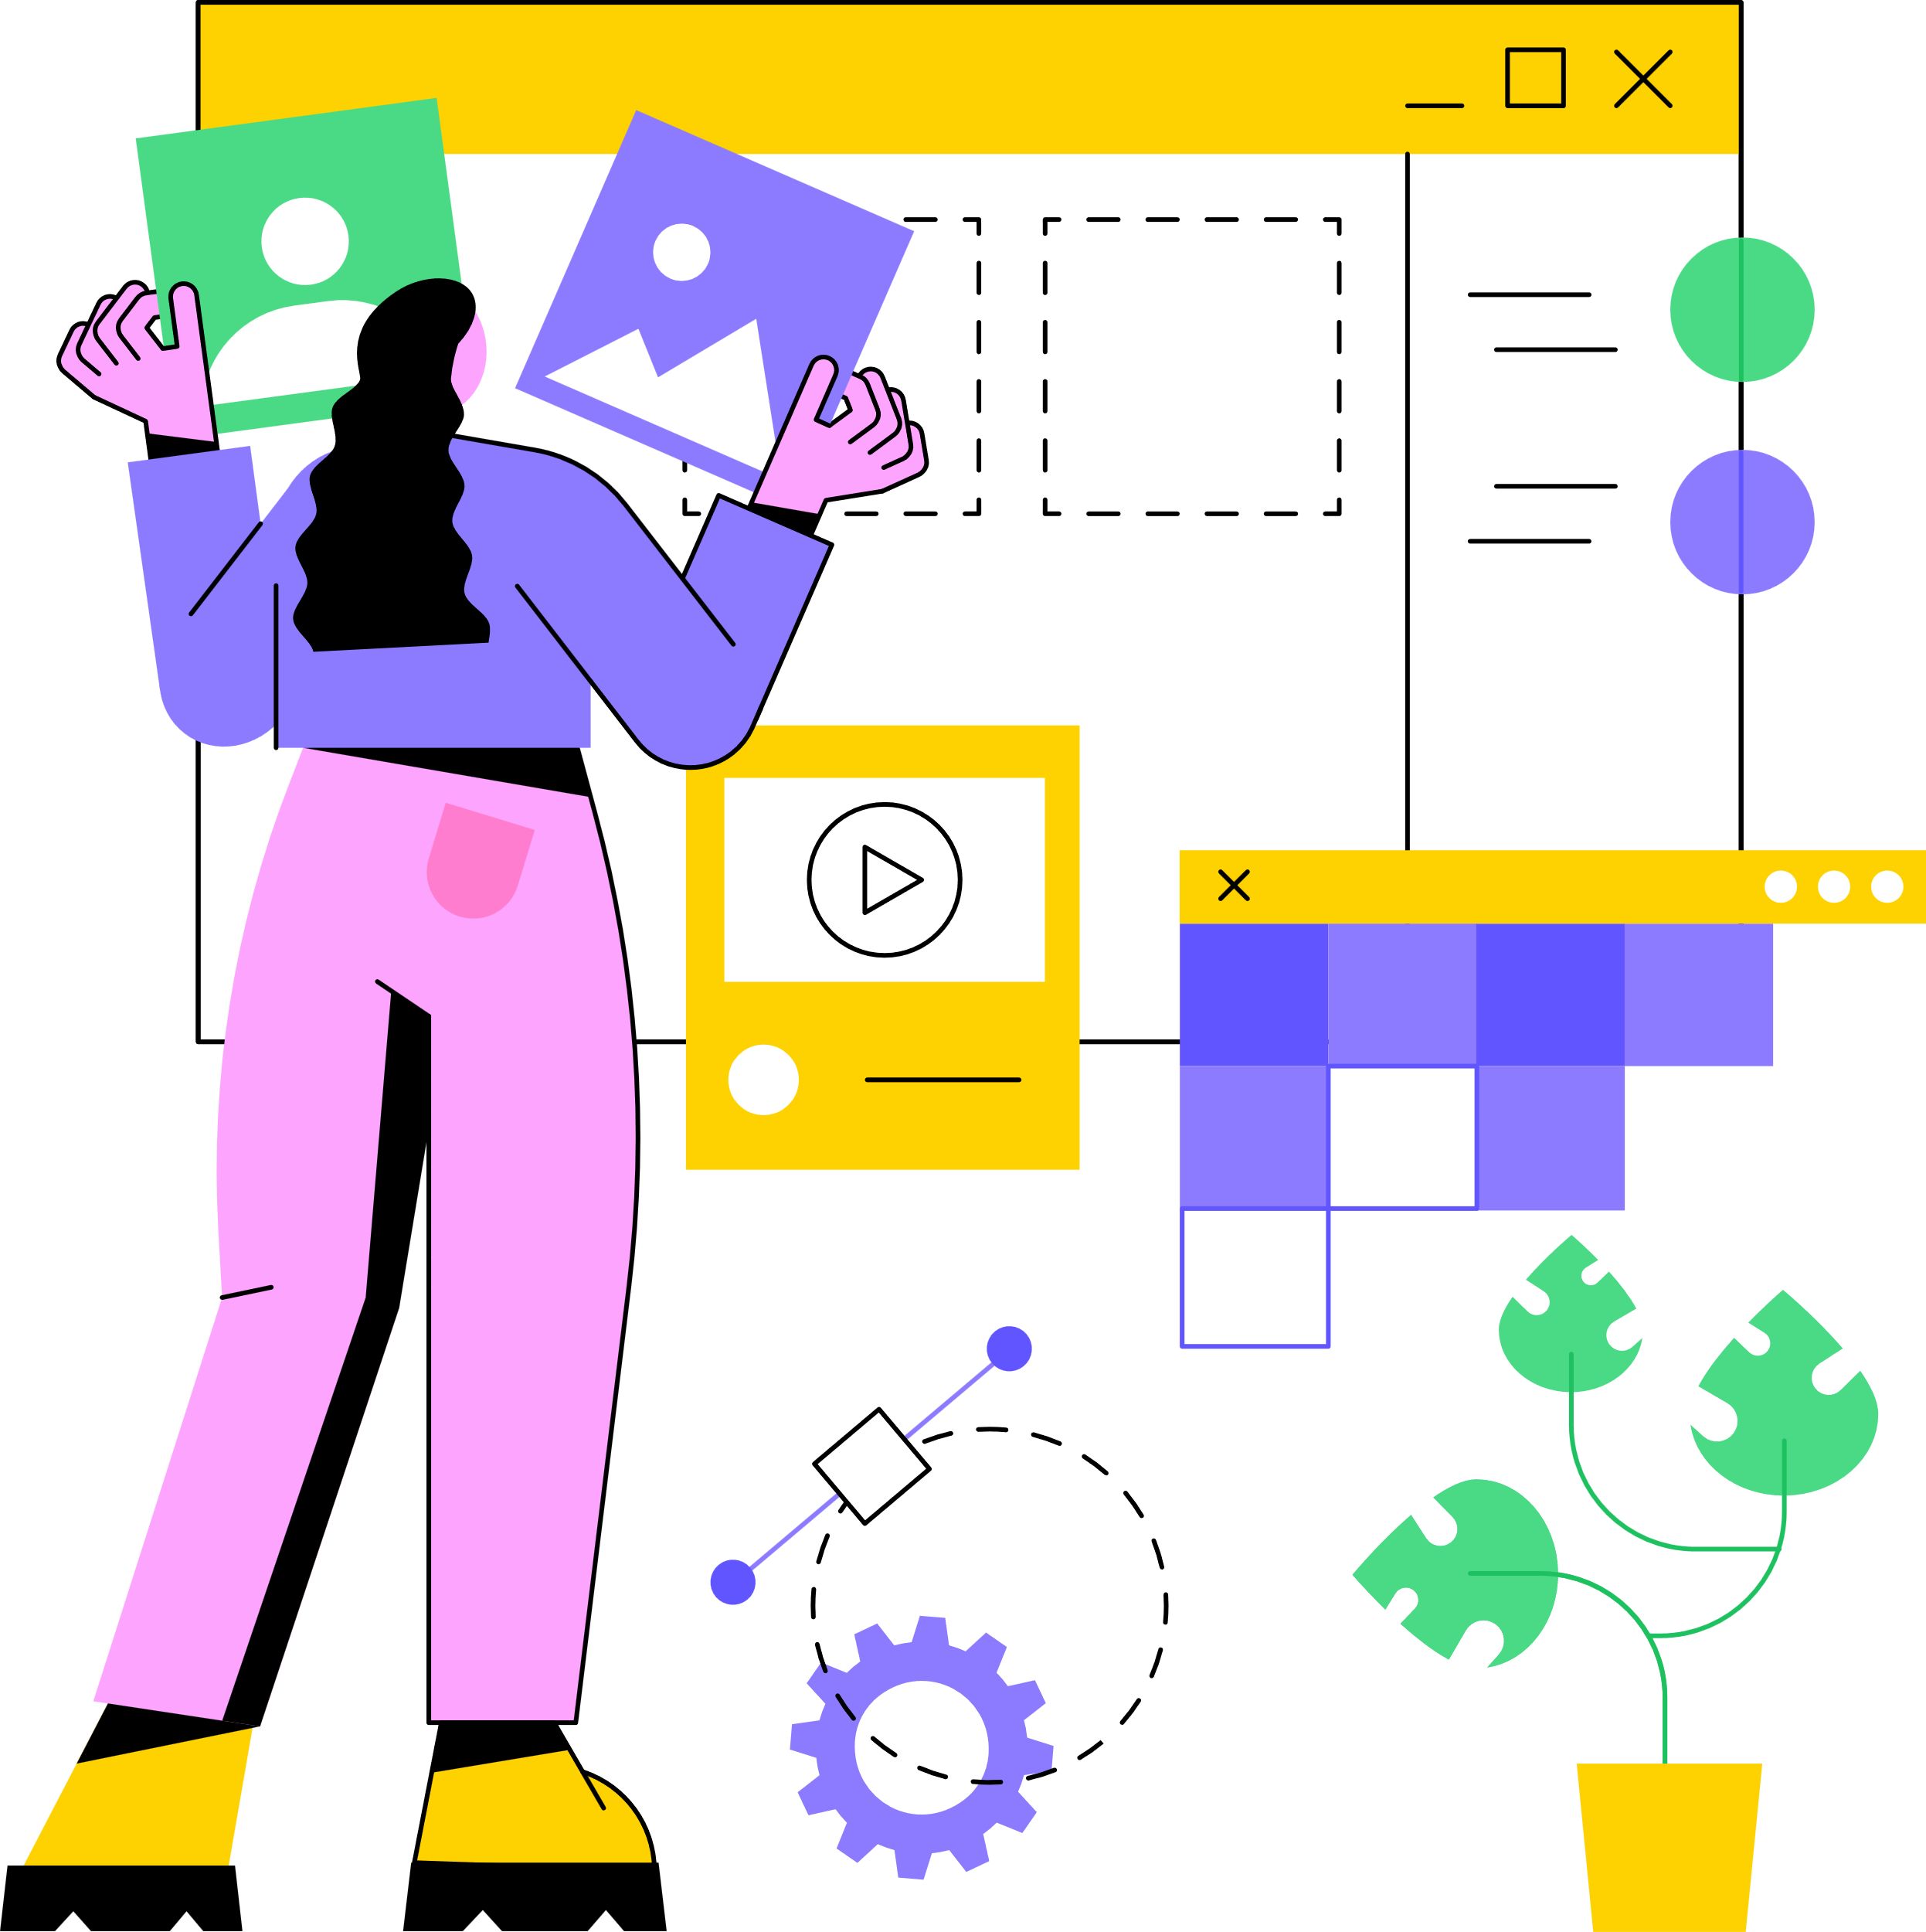
Front End
The front end of a web application refers to the client-side components and user interface that users interact with directly. It is responsible for presenting the application's content and functionality in a visually appealing and user-friendly manner.
HTML/CSS
JS COOKIE
REACT.JS
ROUTER-DOM
REDUX
FORMIK
MOMENT

Slide 11
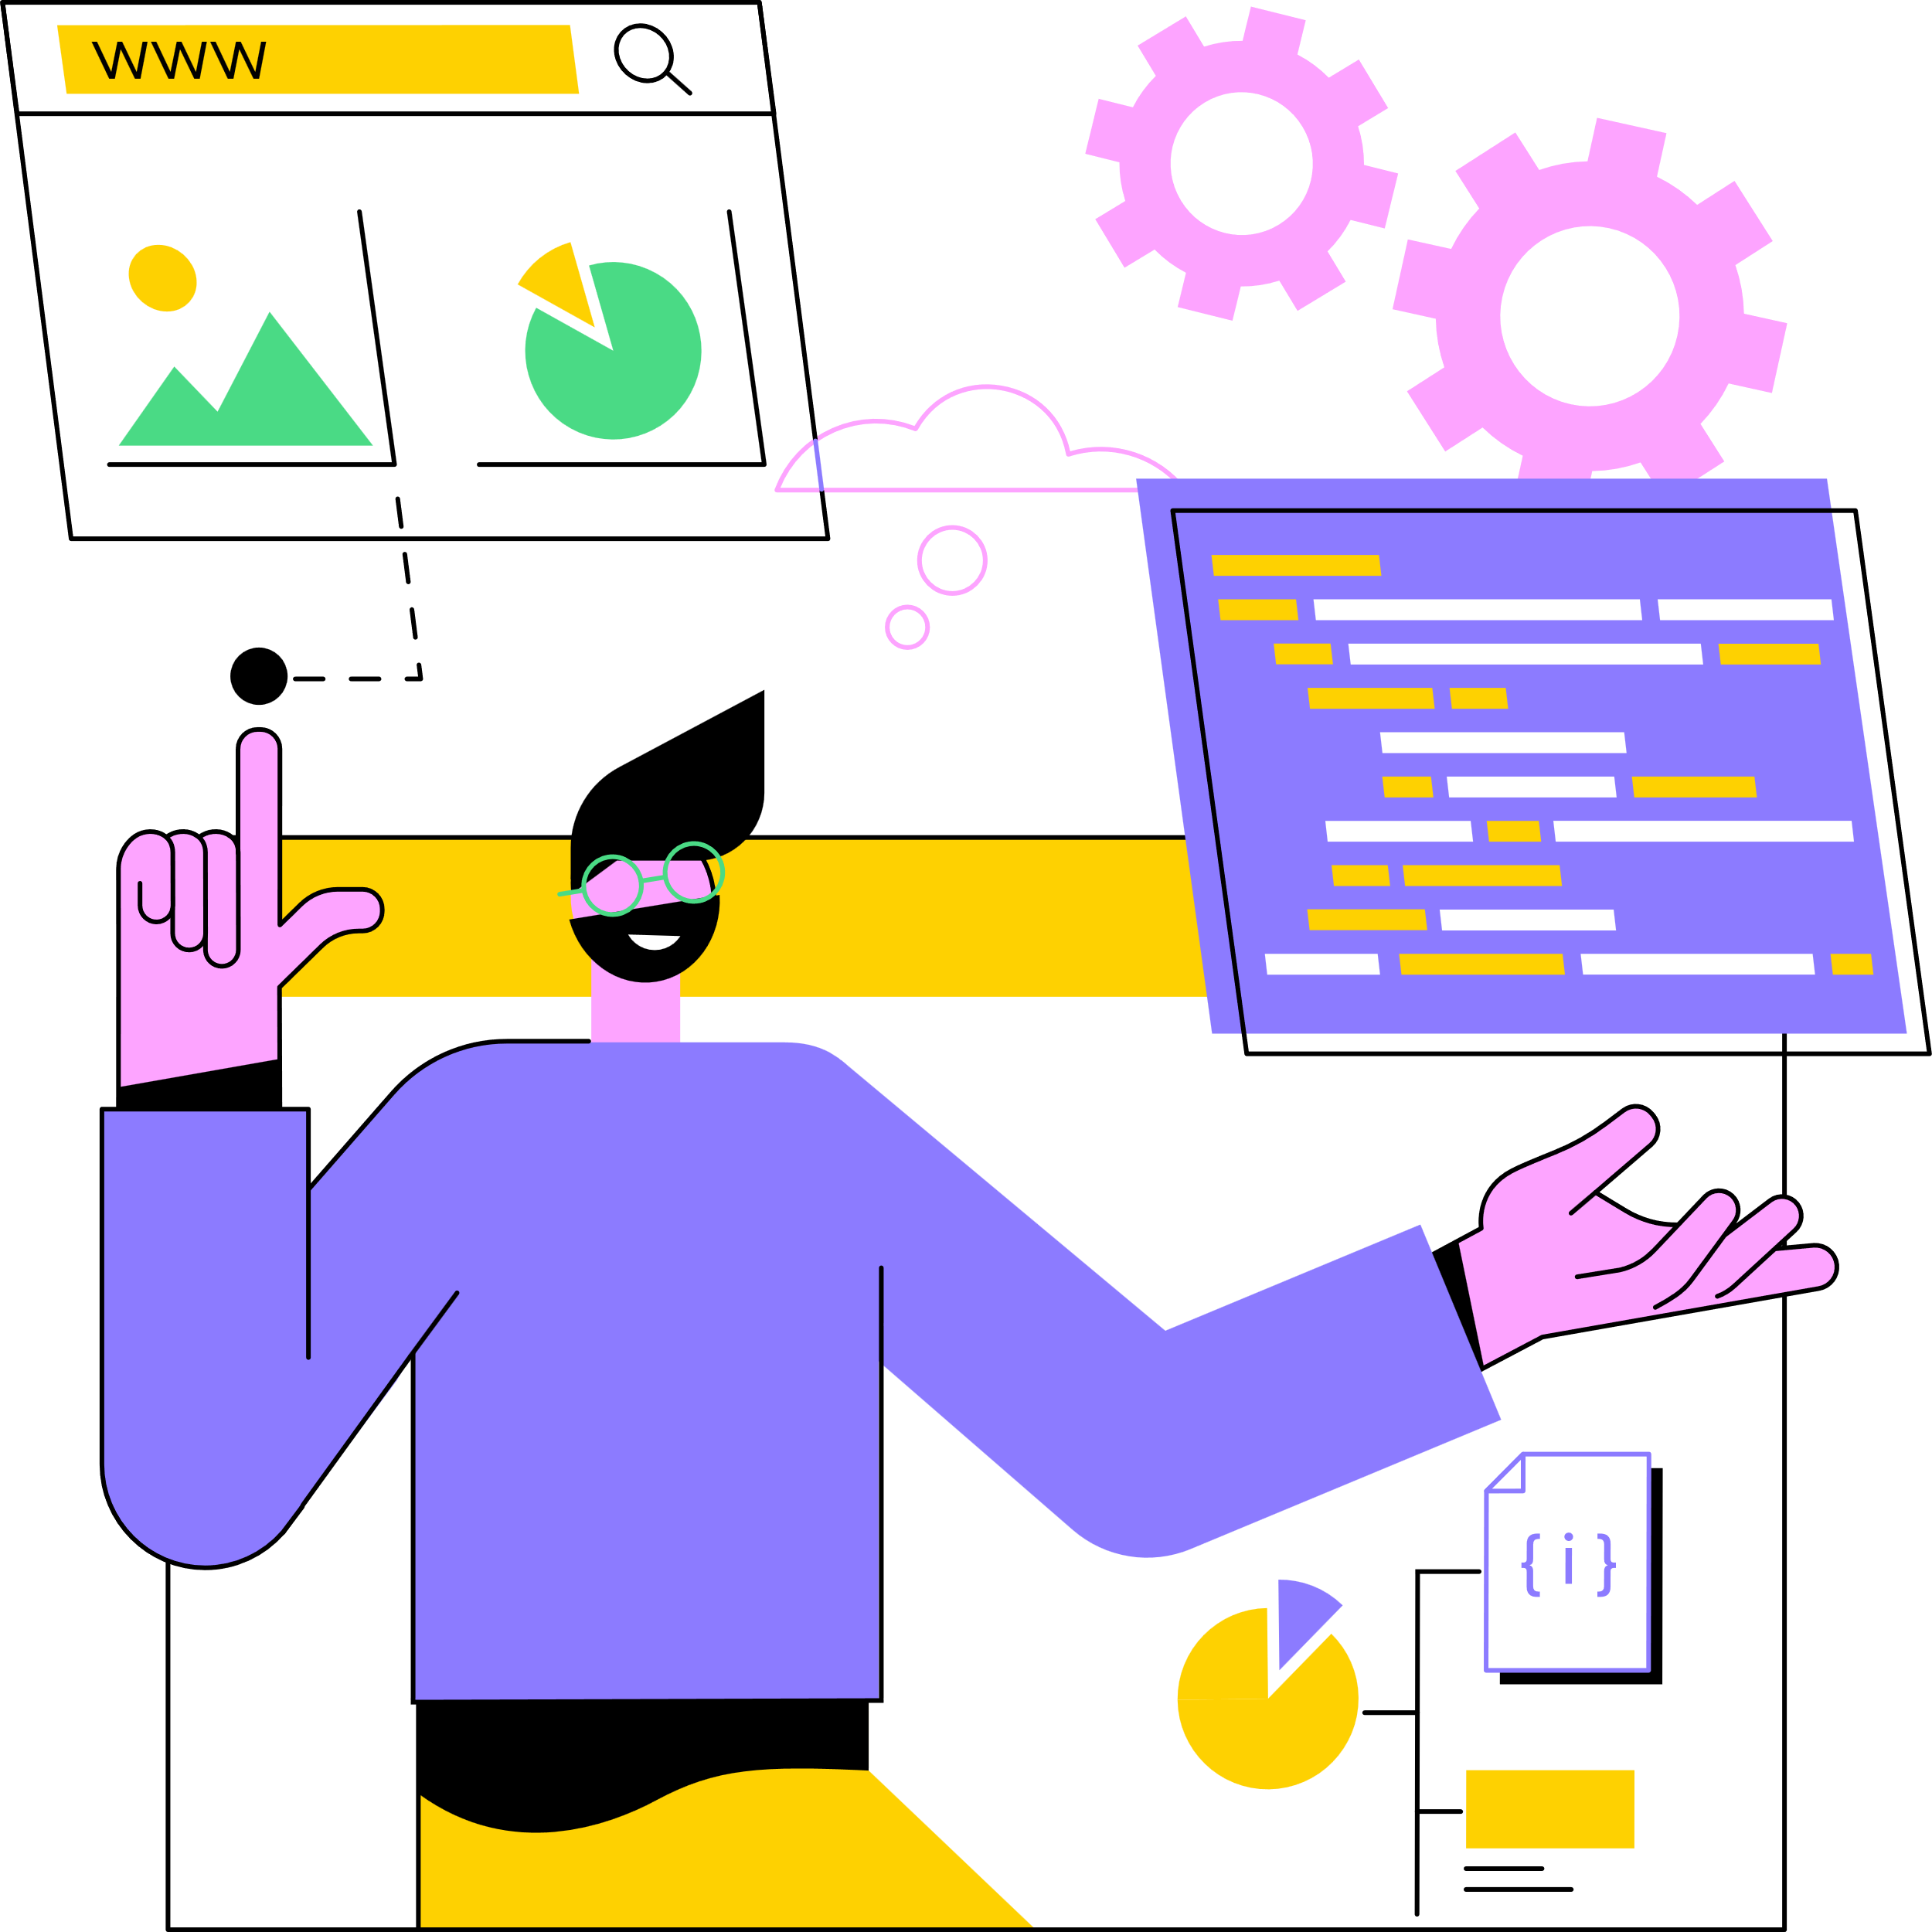
Back End
The back end of a web application refers to the server-side components that handle the processing, storage, and retrieval of data, as well as the business logic of the application. It is responsible for the behind-the-scenes operations that support the functionality and data management of the application.
EXPRESS
NODE.JS
JWT
AUTHENTICATION
API (Get, Post, Put, Delete)

Slide 12
Features and Explanation
A social media website typically encompasses a wide range of features that enable users to connect, share, and interact with others.
LogIn/Register/Logout
Reset Password
Add Post
Like/Comment
Profile

Slide 13

Features and Explanation
A social media website typically encompasses a wide range of features that enable users to connect, share, and interact with others.
Edit/Add Bio
Friend Requests
News Feed
Reactions

Slide 14
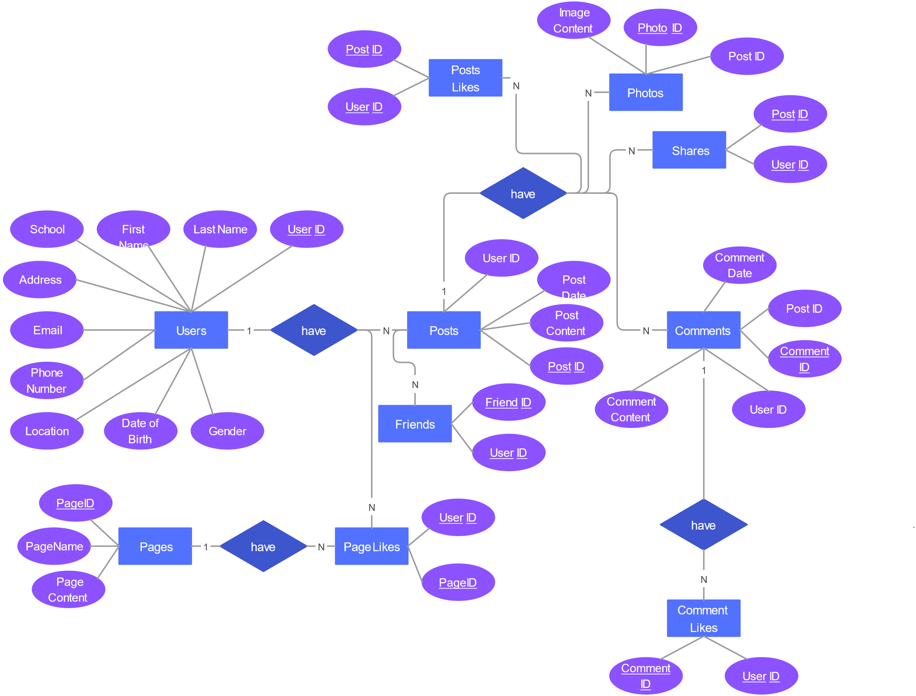
ER Diagram

Slide 15
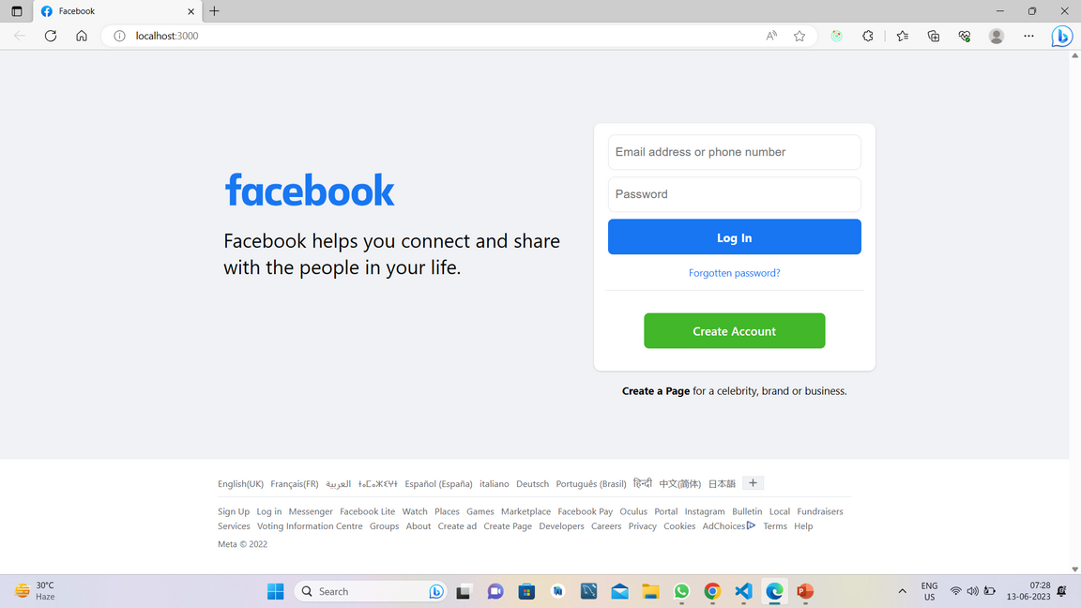
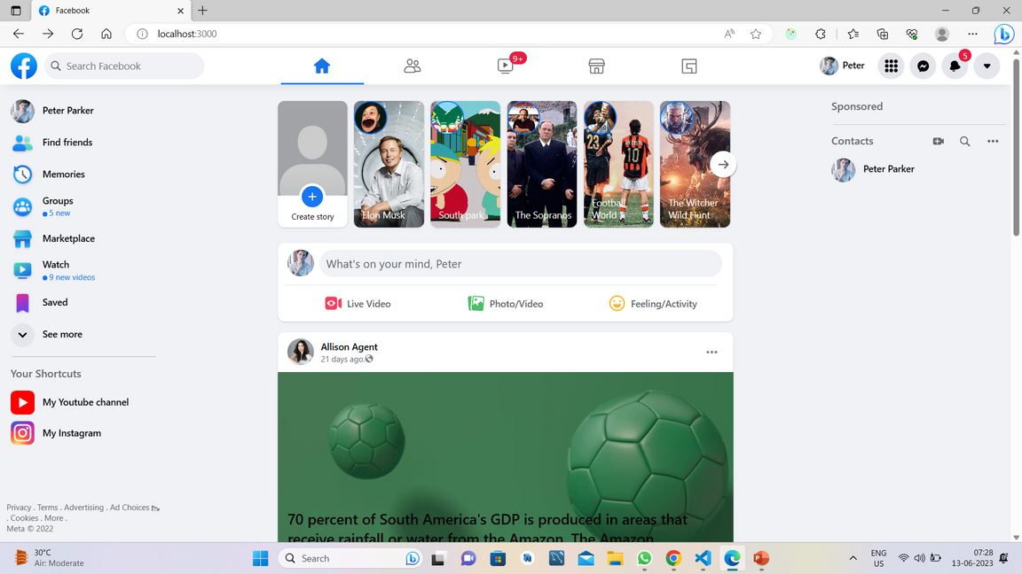
Project Snapshots

Slide 16
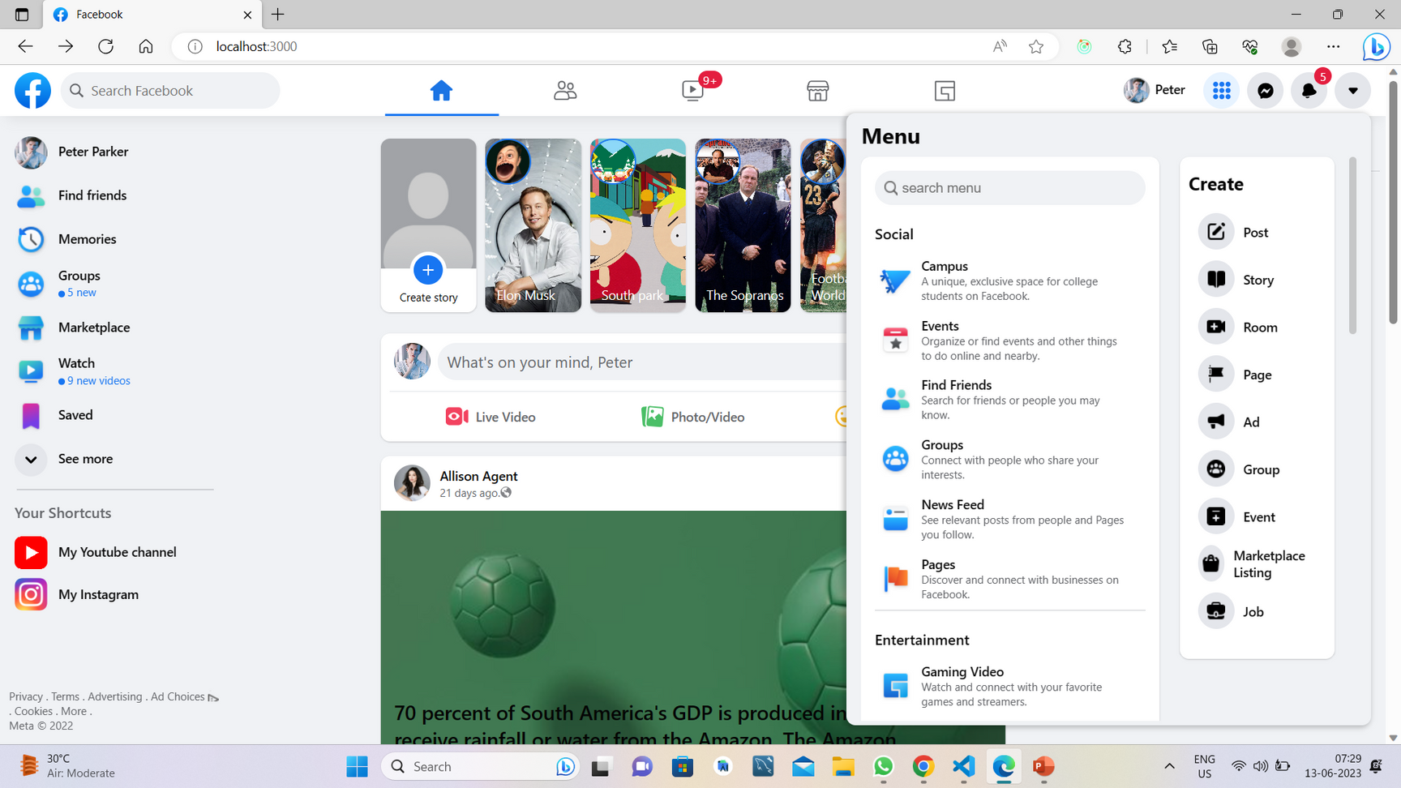
Project Snapshots

Slide 17
Conclusion
In conclusion, the development of a social media website using the MERN (MongoDB, Express.js, React.js, Node.js) technology stack offers numerous advantages and opportunities. The MERN stack provides a robust and efficient framework for building a scalable and interactive social media platform.
As we move forward, we remain committed to enhancing the platform, incorporating user feedback, and continuously improving its features and functionalities. With the MERN stack as our foundation, we are confident in the scalability, performance, and potential for innovation that our social media website possesses.

Slide 18



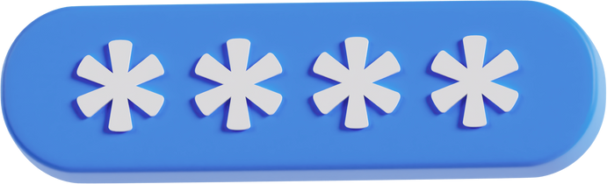
Do You Have Any Question?
End of Slide

